Slide 1
DSE ODBC Driver Installation and Use
© 2018 DataStax, All Rights Reserved. DataStax is a registered trademark of DataStax, Inc. and its subsidiaries in the United States and/or other countries. Apache Cassandra, Apache, Spark, and Cassandra are trademarks of the Apache Software Foundation or its subsidiaries in Canada, the United States and/or other countries.
Notes:
Welcome. This brief tutorial shows how to install and use the DataStax Enterprise ODBC driver to enable queries from third-party, SQL-based tools.

Slide 2
Agenda
Install the DSE ODBC driver
Connect
Query
Notes:
Here is our agenda.
First we’ll install the ODBC driver in on a Windows machine. If you are using Mac or Linux, see the driver documentation for instructions. Next, we’ll make a connection using an ODBC Data Source Name (or DSN), and execute some queries using Microsoft Office Excel as our client tool.

Slide 3
Install ODBC Driver
Notes:
Let’s install the DSE ODBC driver.

Slide 4
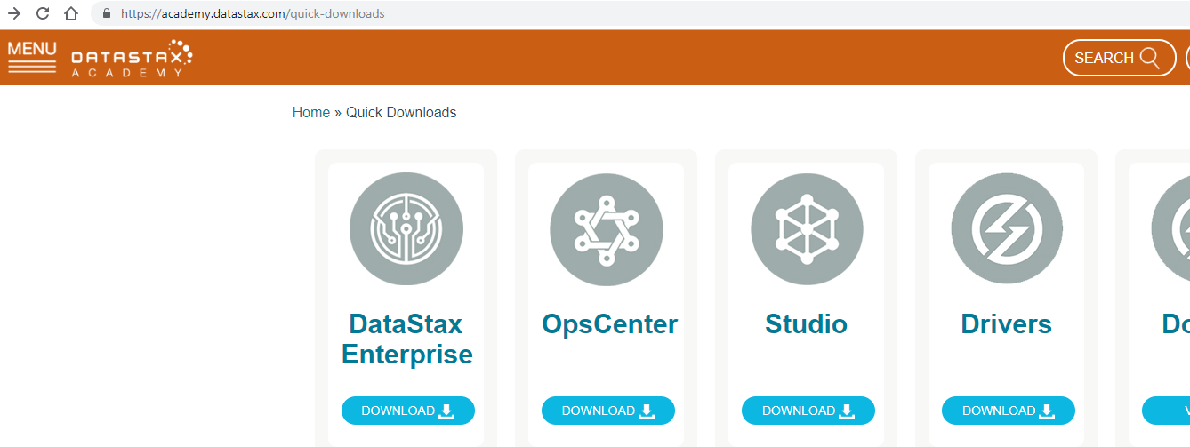
Install ODBC Driver
Notes:
Go to the DataStax Academy Downloads page…
<CLICK> … and click the link to Download Drivers.

Slide 5
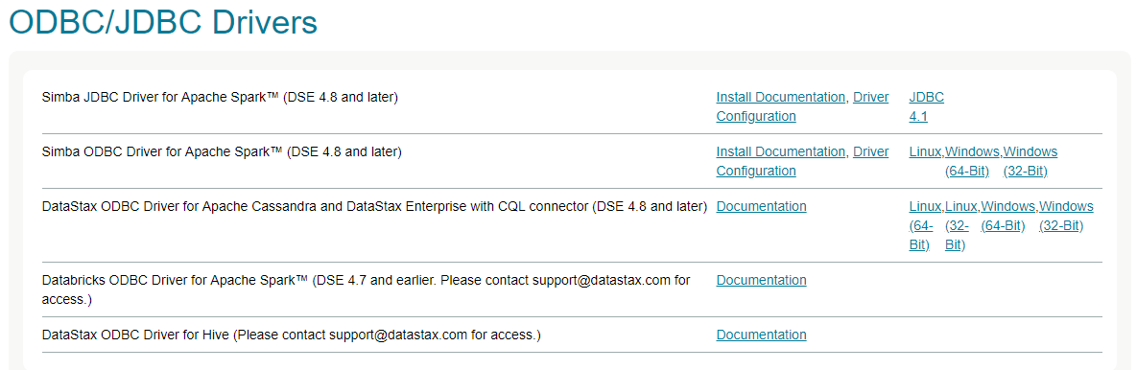
Install ODBC Driver
Notes:
Scroll down the page until you find the ODBC/JDBC Drivers section, and choose the Simba ODBC Driver.
<CLICK> Note that both 32-bit and 64-bit drivers are available. The bitness you need is dependent on the specific client application you want to run. It is NOT dependent on the bitness of your Operating System. You can install both versions if you like.
The downloads are Microsoft Installer files. Double-click and follow the instructions to install.

Slide 6
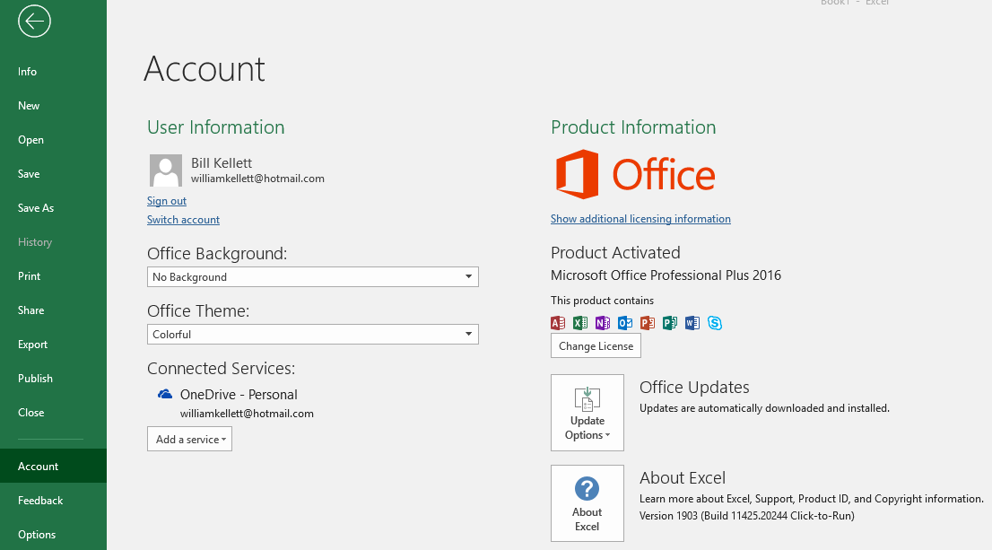
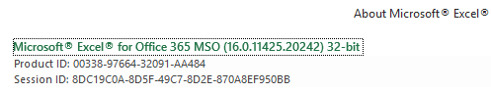
Install ODBC Driver
Notes:
Let’s see what bitness I need. I’ll be using Excel, so I go to the File tab in Excel and click Account…
<CLICK> … then About Excel.
<CLICK> I see that my bitness is 32, even though my Operating System is 64-bit.

Slide 7
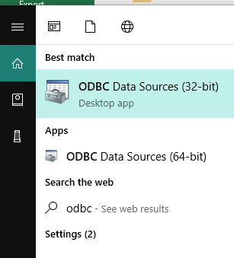
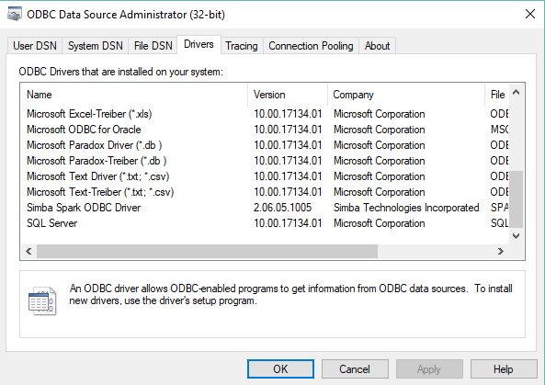
Install ODBC Driver
Notes:
I type ODBC into the Windows search box and select the 32 bit configuration app.
<CLICK> Go to the Drivers tab and verify that the driver is installed.

Slide 8
Connect
Notes:
Now we’re ready to make our connection.

Slide 9
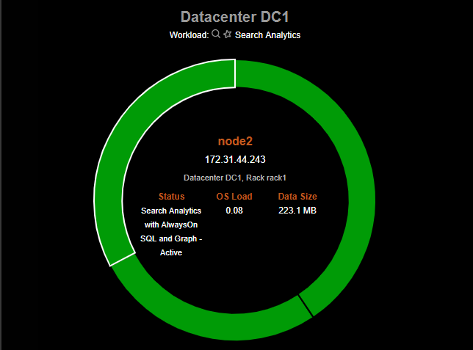
Connect
Notes:
First we need to find a specific IP address for making our connection. Here I’m using OpsCenter.
<CLICK> I see that node 2 is configured for AlwaysOnSQL…
<CLICK> … so I take note of its internal IP address, and relate the internal IP address to the external IP address.

Slide 10
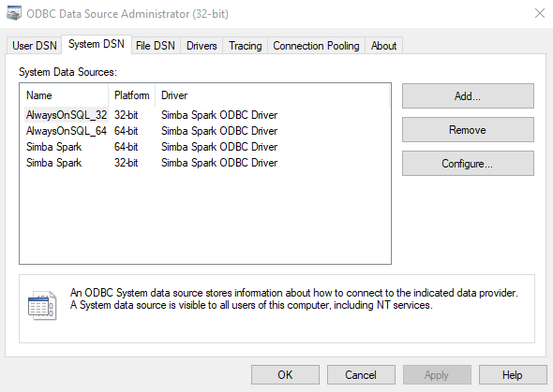
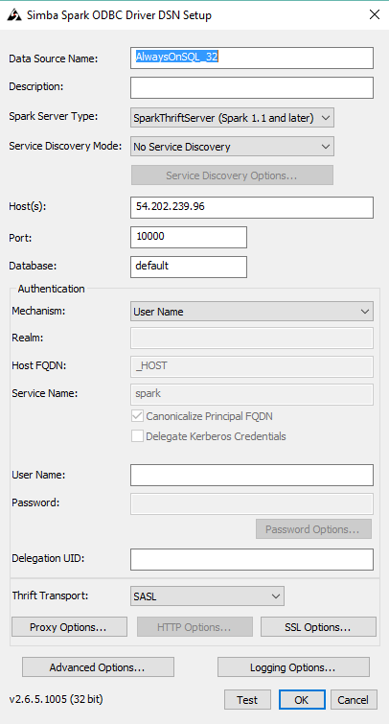
Connect
Notes:
Now go the System DSN tab of the ODBC configuration app and click Add.
<CLICK> Fill out the configuration information as shown here.
<CLICK> Give the DSN any name you like.
<CLICK > Make sure Spark Thrift Server is selected.
<CLICK> For this demo we won’t be using the Discovery service. If you want to try it, it runs on port 9077.
<CLICK> Enter the host name you found earlier.
<CLICK> 10,000 is the default port.
<CLICK> You can enter a specific starting-point database if you like. I’m using default.
<CLICK> For this demo cluster, I don’t need a user ID or password.
<CLICK> It’s a good idea to test the connection.

Slide 11
Query
Notes:
Let’s query the database.

Slide 12
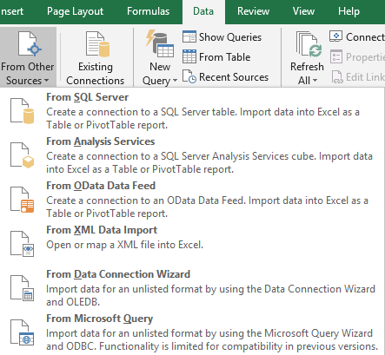
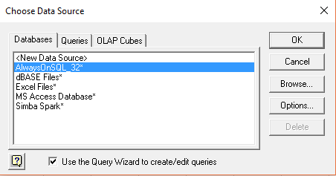
Query
Notes:
I go to Excel and select Data…
<CLICK> … From Other Sources…
<CLICK> … from Microsoft Query.
<CLICK> Select the data source we just created.

Slide 13
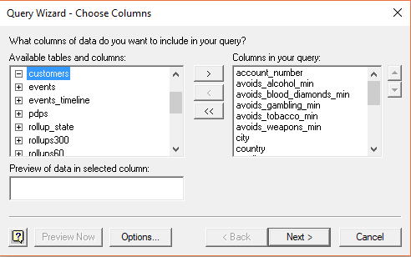
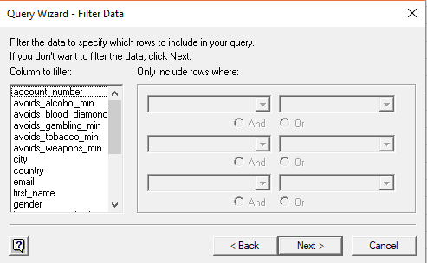
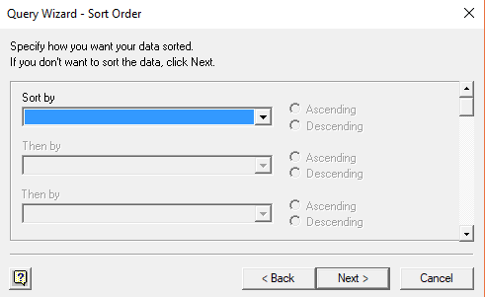
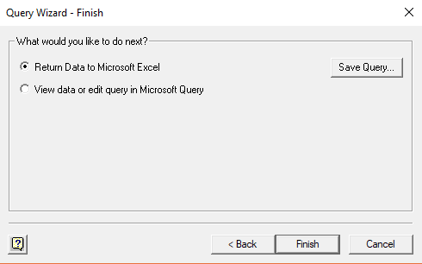
Query
Notes:
Now work through the Query Wizard to choose tables and columns…
<CLICK> … add filters…
<CLICK> … choose sort order….
<CLICK> … and return the data to Excel.

Slide 14
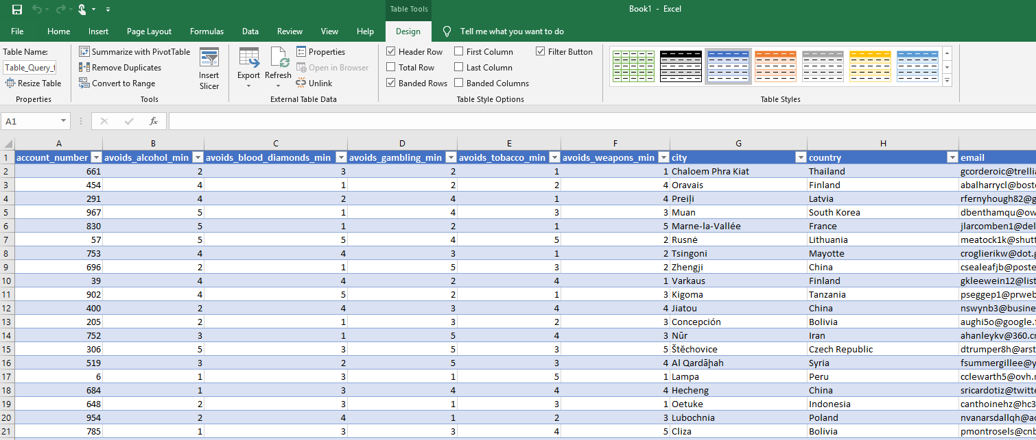
Query
Notes:
The DSE data is returned. Thanks to the ODBC driver, Excel thinks our DataStax cluster is just an ordinary SQL database.
We have created an ODBC connection to DSE and queried the data from Excel. Our task is complete.

Slide 15

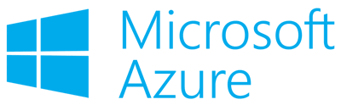







Thank you!
Your Datacenter
Masterless and Active Everywhere Database
Contextual
Always-On
Real-Time
Distributed
Scalable
Notes:
Thank you.

